Slide 1
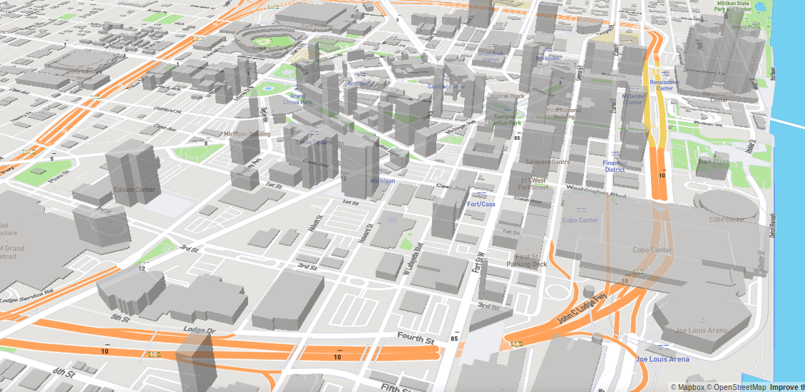
SEMCOG-UrbanSim Bi-weekly
May 16, 2019
Notes:
In this chapter, we will discuss the theoretical basis of UrbanSim at a conceptual level.
Given time constraints, we won’t be able to dive very deeply into the mathematics of the model, but if you are interested in this, at the end of this course we will point you in the direction to where you can fine more technical resources.

Slide 2
Areas of work
Iterating on regionally-estimated specifications, conducting runs, and comparing loss scores / case-study indicators with runs 4036
Setting up calibration script to calibrate each location choice submodel, with the official forecast as the target

Slide 3
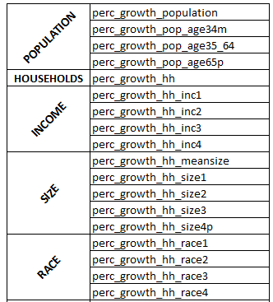
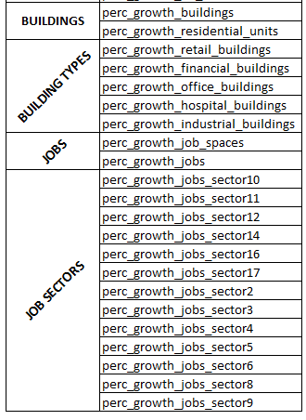
Metrics

Slide 4
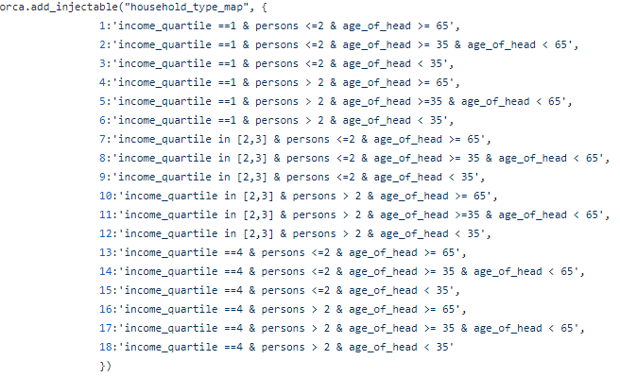
Household Segments
Categories cuts:
Income quartiles: 1, 2&3, 4
Size: <=2 , >2
Age of head: < 35, >=35 & < 65, >=65

Slide 5
SIMULATION RUNS: Specs
SIMPLIFIED RUN: simulation with only the following models:
SEMCOG AS IS: semcog_urbansim repo Simulation models *
REGIONAL SPECIFICATIONS: location choice and price specifications don’t control for large areas.
LARGE AREA CONTROL: variables in location choice models control for large areas.
Clustering Variables: models with variables that aggregate by geographic unit but don’t use the pandana variables. Ex: “st_zones_prop_hh_with_children”, standardized variable that represents the proportion of households with children in the zone).
Accessibility Variables: variables in models from the pandana models (‘neighborhood_vars’). Example: “st_nodes_walk_percent_low_income”.
Notes:
* orca.run(["refiner", 'build_networks', "neighborhood_vars"] + orca.get_injectable('repm_step_names_regional') + ["increase_property_values"])
orca.run([ "scheduled_demolition_events", "random_demolition_events", "scheduled_development_events", "refiner", "households_transition", "fix_lpr", "households_relocation",
"jobs_transition", "jobs_relocation", "feasibility", "residential_developer", "non_residential_developer"] +
orca.get_injectable('repm_step_names') + ["increase_property_values"] + orca.get_injectable('hlcm_step_names’') + orca.get_injectable('elcm_step_names') +
["elcm_home_based", "jobs_scaling_model", "gq_pop_scaling_model"

Slide 6
SIMULATION RUNS
RUN 4036
SIMPLIFIED RUN WITH REGIONAL SPECIFICATIONS (Accessibility Variables)
SIMPLIFIED RUN WITH REGIONAL SPECIFICATIONS (Clustering Variables)
SIMPLIFIED RUN WITH LARGE-AREA CONTROL SPECS (Clustering Variables)
SEMCOG AS IS WITH REGIONAL SPECIFICATIONS (Accessibility Variables) (in progress)
SEMCOG AS IS WITH REGIONAL SPECIFICATIONS (Clustering Variables) (in progress)
SEMCOG AS IS WITH LARGE AREA CONTROL SPECIFICATIONS (Clustering Variables) (in progress do!)

Slide 7
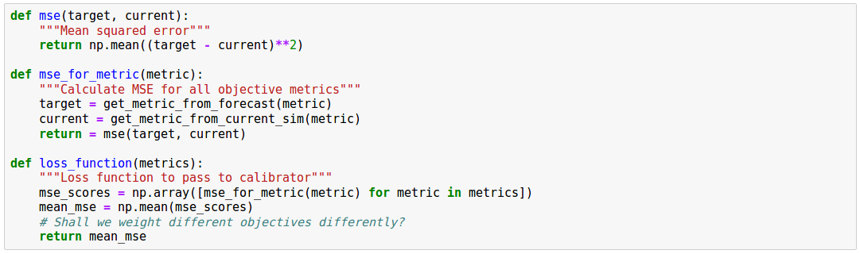
Our project objective
Notes:
Where our target is the official Semcog Results

Slide 8
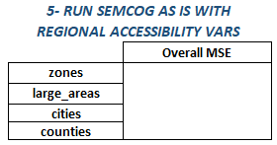
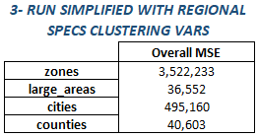
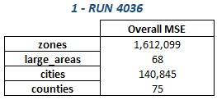
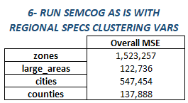
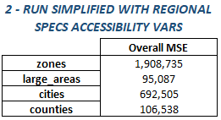
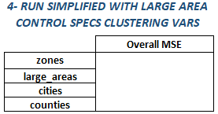
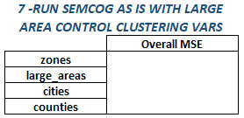
Loss Values for each Run
Notes:
Where our target is the official Semcog Results

Slide 9
Comparison
Notes:
Run #1 and run #2: run #2 poor values on all geographies
Run #1 and run #3: run #3 poor values on all geographies
Run #1 and run #6: run #2 had a lower zones MSE score than run #1
Thoughts: about run#1 vs run#6, regional specifications with clustering variables make zone values better, but bigger geographies worse. We need to see if semcog as is with accessibility variables changes this relationship (run #5) or semcog as is with large area controls (run#7) also changes the relationship

Slide 10
Comparison
Notes:
Run#2 with run #3: using clustering variables is better for all geographies except zones. Accessibility variables make zones MSE better
Run #2 with run#3: mixed case. Zones and cities MSE are better with semcog models and clustering vars but counties and large areas are better without semcog models and with accessibility vars
Run#3 with run #6: isolating the addition of semcog models, with semcog models, zones MSE is better but cities, counties and large area MSE values are better without semcog models

Slide 11
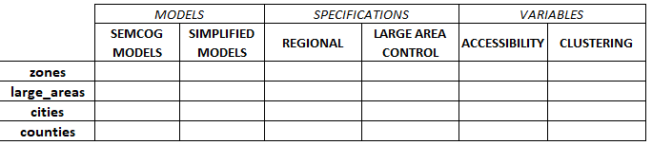
Effects
Notes:
We need to complete the simulation of three more runs to get to better conclusions about the effects of different variables and regional o large area controls

Slide 12
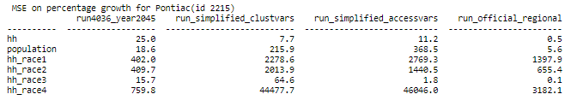
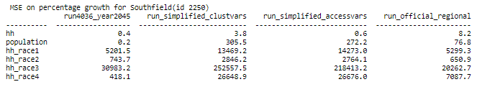
Case Studies: HLCM issues
semcog
semcog
Notes:
Case Studies:
- Pontiac (SEMMCD= 2215): urban declining city, large concentrations of black pop growing over the years
- Southfield (SEMMCD= 2250): urban declining city, large concentrations of black pop growing over the years

Slide 13
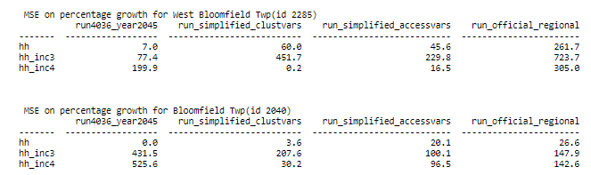
Case Studies: HLCM issues
semcog
semcog
Notes:
Case Studies:
- West Bloomfield Twp (SEMMCD= 2285): Affluent community, should be gaining income 4 hh.
- Bloomfield Twp (SEMMCD= 2040): Affluent community, should be gaining income 4 hh.

Slide 14
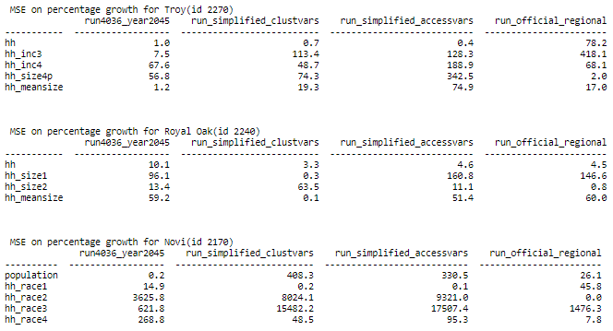
Case Studies: HLCM issues
semcog
semcog
semcog
Notes:
Case Studies:
- Troy (SEMMCD= 2270): Affluent community , should be gaining income 4 hh. Diverse community with high and stable hh size with children (likely to keep the same track)
- Royal Oak (SEMMCD = 2240): built-up city with hh size of 2 (likely to stay close to that number)
- Novi (SEMMCD = 2170): high concentrations of Asian population (likely to keep that way)

Slide 15
Calibration phases
Calibrate each submodel separately
Calibrate model components together

Slide 16
Calibrating a location choice submodel
Define the computation graph (next slide)
Define the loss function as how close results are to the official forecast, for the agent category of interest, e.g. change in number of households of type 7
Apply differentiation to get gradients of the loss with respect to MNL parameters
Once we have gradients, conduct gradient-based optimization (gradient descent) to arrive at MNL parameters that minimize loss
Take the calibrated coefficients and swap them into UrbanSim
Run a test simulation to check that results moved in the direction of targets in an actual simulation context

Slide 17
loss
MSE
sum by geog
targets
capacities
capacity constrain
D
mul by demand
softmax
MUL
X
W

Slide 18
loss
scalar value
MSE
sum by geog
targets
longitudinal data as represented by official forecast
growth prediction
capacities
capacity constrain
geog demand
D
mul by demand
proba
softmax
logits
MUL
explanatory vars
X
W
MNL parameters

Slide 19
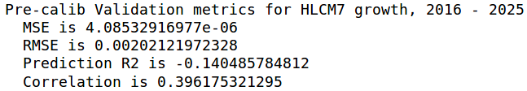
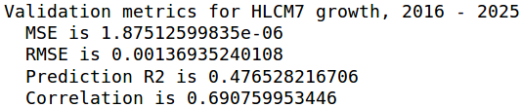
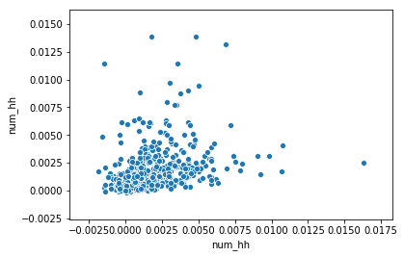
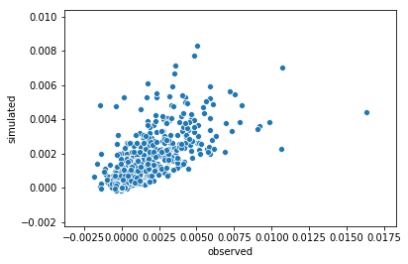
Test run of calibrated coefficients- HLCM7 in Oakland County

Slide 20
Next step
Refine submodel-specific targets from official forecast
Loop through each large area, and each location choice submodel, and calibrate each separately
Run a simulation with all calibrated coefficients

